Slide 1
The INTOSAI Capacity Building Committee 2.0
Magnus Lindell, CBC Vice Chair and Deputy Auditor General of Sweden

Slide 2
CBC 2014
New chair (SAI SA) and vice chair (SAI Sweden)
New joint secretariat
Strategic thinking phase
Annual CBC meeting in Lima, Peru (Sept ‘14)

Slide 3
CBC Value Proposition
The CBC is the INTOSAI advocate for SAI capacity development, who strives to lead by example by being a model community of practice in relation to all INTOSAI capacity building activities. It focuses on:
Integrating the work of the CBC’s different bodies into a more agile and flexible structure
Building and nurturing relationships with other actors in the SAI capacity building arena, inside and outside of INTOSAI
Supporting the important role of the INTOSAI regions in capacity development

Slide 4
2014 Annual CBC Meeting
Value proposition
Regional involvement
Fresh strategic thinking
“Universe of desirables”
“Focus on the feasible”

Slide 5
Strategic issues
Identify capacity development priorities
Enable capacity development through knowledge sharing
Facilitate regional cooperation and integration
Engage with development community

Slide 6
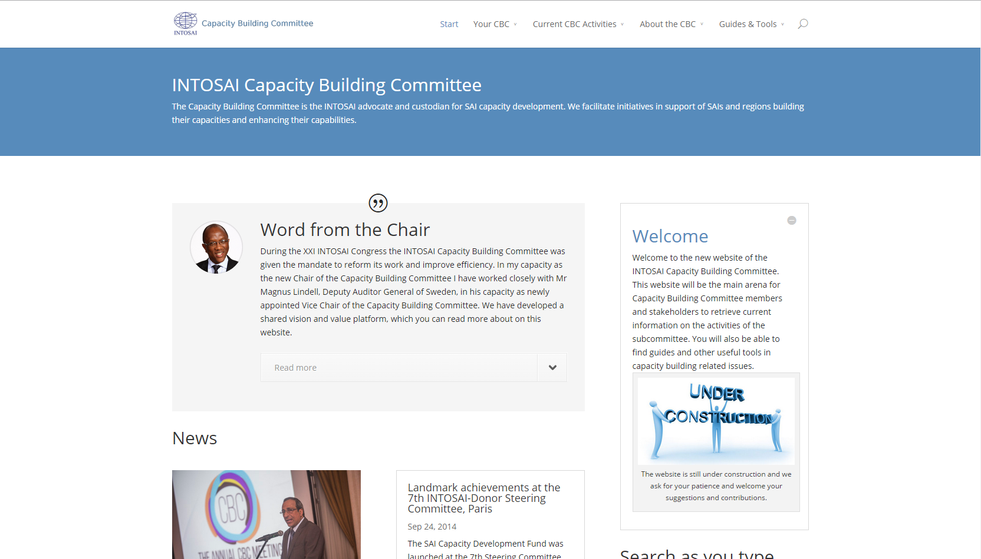
www.intosaicbc.org

Slide 7
Work streams
Promote INTOSAI professional development as anchor for capacity development
Promote benefits of cooperative audits as capacity development tool
Support verification of capacity development efforts
Draft guidance in support of specific SAI capacity development needs not available elsewhere
Promote IntoSAINT as a capacity development tool

