Slide 1
14th Meeting of the Steering Committee on Knowledge Sharing and Knowledge Services
A.I. 3
Presentation by INTOSAI General Secretariat

Slide 2
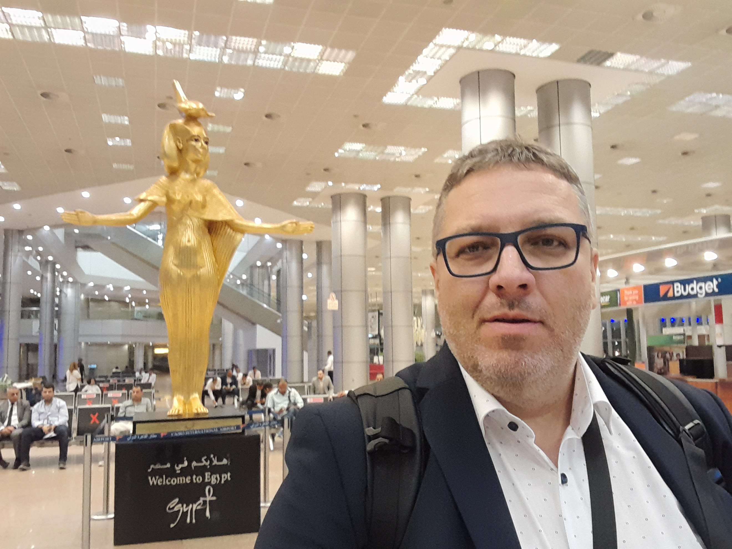
Herbert
Herbert BAUMGARTNER
INTOSAI General Secretariat
Deputy Director

Slide 3
XXIV INCOSAI 2022
INTOSAI’s operations in times of the pandemic
Global SAI Stocktaking Report 2020
Independence initiatives
INTOSAI delegation renders a visit to the UN SG
Task Force on Strategic Planning
Task Force on INTOSAI Communication
INTOSAI Side Event at the UN HLPF in New York

