Slide 1
2022
INTOSAI Working Group on Public Procurement (WGPPA)

Slide 2
INTOSAI Task Force on Public Procurement Audit
2013-2016
Features
Joint initiative by the Accounts Chamber of the Russian Federation and the U.S. Government Accountability Office
Approved by INTOSAI Governing Board and XXI INCOSAI in China in November 2013
Chaired by SAI Russia
Work results
Examined international experience in auditing public procurement
Implemented pilot projects on auditing public procurement with SAI Portugal, Slovenia, Zambia
Developed INTOSAI Glossary on Public Procurement Audit
2

Slide 3
INTOSAI Working group on Public Procurement Audit (WGPPA)
Basics
Established in December 2016 at the XXII INCOSAI in Abu Dhabi, UAE on the basis of the Task Force
Secretariat of WG PPA was established to coordinate the activities of member SAIs
Secretariat is chaired by SAI Russia
Strategic goal
Assist SAIs in developing common methodological approaches to public procurement audit
Increase SAIs contribution to ensuring accountability and transparency of public administration
3

Slide 4
INTOSAI Working group on Public Procurement Audit (WGPPA)
Goal 1
Develop an international Guidance on Public Procurement Audit
Objectives
Monitor international activities and trends in public procurement audit
Develop a Guidance according to the Due Process for the INTOSAI Framework of Professional Pronouncements
Goal 2
Further development of methodological frameworks and information exchange
Objectives
Create a permanent system of experience exchange
Elaborate a database of best practices in public procurement audit
Develop new manuals and guidances for specific areas of public procurement audit
4

Slide 5
WG PPA – Current state
1. | Russia (Chair) | 12. | Kyrgyzstan
2. | Armenia | 12. | Pakistan
3. | Azerbaijan | 13. | Philippines
4. | Belarus | 14. | Portugal
5. | China | 15. | Serbia
6. | Georgia | 16. | Slovenia
7. | India | 17. | Thailand
8. | Jamaica | 18. | UAE
9. | Kazakhstan | 19. | Zambia
10. | Kuwait
19
Member SAIs
As of September 2022
5

Slide 6
GUID 5280 – General Information
Key activity of the INTOSAI Working Group on Public Procurement
Non-mandatory guidelines for auditing subject matter of Public Procurement
Guidance and Reference on ISSAI 300 and ISSAI 400 application
6

Slide 7
GUID 5280 – Key Milestones
Final pronouncement
by the Governing Board
Project Proposal submitted and approved by FIPP
Consultations with FIPP & PSC subcommittees
Exposure Period
September
2022
February
2022
2019
February
2018
2020–2021
March-June 2022
November
2022
Exposure Draft Developed by WGPPA
Conditional approval of the Exposure Draft by FIPP
Approval of the Endorsement version by FIPP
7

Slide 8
GUID 5280 – Key Features
Comprehen-sive
Applicable for all SAIs in different jurisdictions
Applicable for combined audits
Integrated view of public procurement
Extensive supple-mentary material
Versatile
Applicable for all SAIs in different jurisdictions (approaches and methogology of different SAIs and International organizations)
Comprehensive (Covers all audit cycle, e.g. planning, conducting, reporting and follow-up)
Applicable for combined audits (covers performance and compliance audit)
Integrated view of public procurement (strategic and process method to public procurement)
Versatile (takes into both public procurement in emergencies + the role of new technologies and appoaches to audit, e.g. data analysis)
Provides extensive supplementary material (examples of audit questions, audit risks)
8

Slide 9
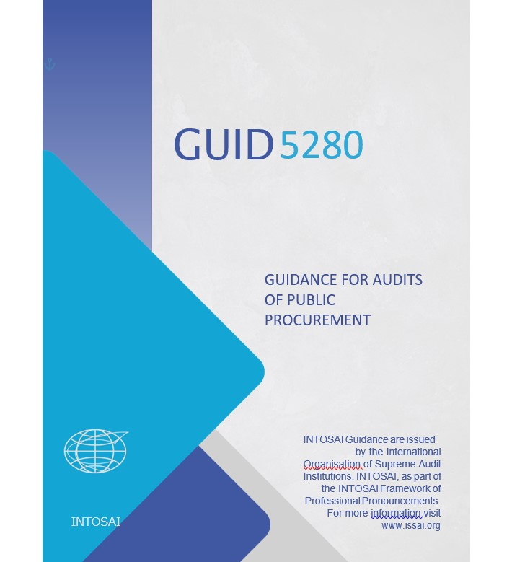
GUID 5280 – Structure
Introduction
Objectives
Definitions
Scope
The objective of the audit
Some considerations when defining the objective of the audit
Planning the audit
Conducting the audit
Reporting and Follow-up
Annexures
9

Slide 10
GUID 5280 – Introduction
Public procurement provides up to 20% of global GDP
This section introduces the purpose of the GUID, e.g. helping the auditor in understanding a specific subject matter of public procurement and in applying relevant ISSAIs in that context
The section provides general overview of public procurement sector – its role in global and national economies and key aspects of its regulation
10

Slide 11
GUID 5280 – Objectives, Definitions, Scope
The sections refer to general issues regarding the GUID objective and applicability
The GUID is a tool for auditors to help them use relevant ISSAIs, when conducting specific subject matter audit
This GUID is a tool to help auditors in planning and performing a procurement related audit on all stages
For the purpose of streamlined narrative, the majority of definitions were moved to Annexures section (leaving only the definition of public procurement)
11

Slide 12
GUID 5280 – Objective of the Audit
Special attention paid to identifying the objective of the audit (e.g. responsible parties, defining the subject matter, relevant criteria,, corruption and fraud risks, procurement in emergencies);
The section also discusses the principles behind performance (3E) and compliance audit (applicable legislation);
It also discusses the relation between the two types audit, when conducting a combined audit of public procurement
12

Slide 13
GUID 5280 – SOME CONSIDERATIONS WHEN DEFINING THE OBJECTIVE OF THE AUDIT
The section describes some different specific options and circumstances, which auditors may find helpful to consider when defining the objective of the audit
Two general methods to public procurement – strategic and process method
Strategic method
Procurement activities are linked to and embed in overall national priorities
Process method
Procurement is organised according to applicable regulations and can be divided into distinct operational phases of the end-to-end cycle
Procurement Performance Model
Typical activities that result or contribute to the control aspects required in public procurement
13

Slide 14
GUID 5280 – SOME CONSIDERATIONS WHEN DEFINING THE OBJECTIVE OF THE AUDIT
Corruption and Fraud risks add up to 25% additional cost
Avoiding costly and ineffective procurement requires thorough risk analysis
The section provides a list of main risk factors of corruption and fraud to be considered during the audit
Emergency situations are considered a separate group of risks
14

Slide 15
GUID 5280 – Audit Cycle
Planning the audit
Conducting the Audit
Reporting
Follow-up
Stages of the audit cycle viewed in separate sections (with particular emphasis on planning)
15

Slide 16
GUID 5280 – Planning the Audit
Planning section extensively discusses choice of topics, audit objectives, approaches, criteria and how to manage audit risks;
The key objective is the selection of topics (based on SAIs capabilities and other factors)
The next stage involves selecting audit objectives and audit approach
The stage is followed by formulating the audit questions and criteria
The final part involves identifying the audit risks
Topics
Objectives
Approach
Audit Questions
Audit Criteria
Audit Risks
What we need?
16

Slide 17
GUID 5280 – Conducting the Audit
Common audit methods like document studies, interviews and wherever possible and appropriate, physical inspections are appropriate and the internal resources to carry out an audit of public procurement are often similar as for other audits
Audit of infrastructural projects or other large technical procurements may require use of technical experts
IT data analytical tools are becoming a strong and increasingly used method to extensively analyze open (or non-open) data on public procurement procedures
For auditing in emergency situations SAIs need to consider some non-standard approaches (e.g. remote audit with the use of IT platforms)
NB!: non-standard approaches require continuous evaluation
17

Slide 18
GUID 5280 – Reporting and Follow-Up
The auditor is expected to provide constructive recommendations that are likely to improve the effectiveness of the procurement process
Reporting section covers most typical situations and audit findings by SAIs when auditing public procurement;
In the follow-up it is prudent to focus more on the final results in improving efficiency and effectiveness, rather than to the process of implementing audit recommendations.
Annexures include key definitions and concepts used in the GUID, principles of public procurement (according to UNCITRAL model law on Procurement of Goods, Construction and Services), possible audit questions (depending on the method used to public procurement), risk matrix for audit process integrity and audit risks list
18

Slide 19
GUID 5280 – Key Changes 2020-2021
Text brought in compliance with IFPP requirements, including the Drafting convention (e.g. the number and contents and order of sections, reference to certain ISSAIs);
Concepts and examples (e.g. substituting the EU-specific norms/examples for OECD ones to make the GUID applicable for all SAIs);
Document made more subject matter specific (relating only to specific standards (ISSAIs), without repeating or duplicating them)
Text streamlined, e.g. general concepts, principles, audit phases and questions moved into Annexures section;
Clear distinction made between audit types covered (compliance and performance audit);
Language edited and improved, topical and terminological consistency ensured throughout the text.
19

Slide 20
GUID 5280 – Other changes
Section “Objectives” and “Scope” split again into 2 separate sections (merged into a single section earlier by the suggestion of the TSF in August, 2021);
All information on general issues on public procurement auditing (including the principles of public procurement) deleted or moved to annexes;
Section “General Concepts” renamed and rearranged into “The objective of the audit” (to clearly link the chapter to the audit process as suggested by FIPP);
Definitions and abbreviations moved to Annexures part;
References to COVID-19 removed, substituted by references to emergencies and GUID 5330;
Several concepts (e.g. “real-time audit”) avoided as suggested by FIPP (since there is no definition of such concepts within the IFPP).
20

Slide 21
WGPPA - Further steps
Key topics
Use of IT in the audit of public procurement: instruments of data analysis, infrastructure, staff skills, open data, remote audit
Audit of public procurement in the context of achieving national priorities and SDGs
Efficiency criteria for public procurement
Priorities of public procurement during and after pandemic
Key challenges and limitations encountered in auditing public procurement
Public procurement and SDGs
Relaunch of the WGPPA
Adoption of the GUID by GB and INCOSAI
Identifying further priorities for the WG
New modalities of the WG
New products of the WG
New techniques
Regular Newsletter
Web site update
21

Slide 22
WGPPA - Further steps
Identifying new priorities
A key task with regards to the future of the WG
Need for active engagement with the SAI community
Survey
December
2022
Priorities of public procurement during and after pandemic
Methods used to public procurement audit
WGPPA meeting
February
2023
Discussing the preliminary results of the survey
Redefining potential priority topics
Relaunch
of the group
Key challenges and limitations encountered in auditing public procurement
Public procurement and SDGs
Identifying possible products (e.g. newsletter, annual report, casebook) for WG and INTOSAI community
Discussing the final results of the survey
Amending the Terms of Reference (if necessary)
Identifying potential new members
Launching new products
22

Slide 23
Thank you!
Accounts Chamber of the Russian Federation

