Slide 1
Update on the RECENT DEVELOPMENTS in INTOSAI Item 4

Slide 2
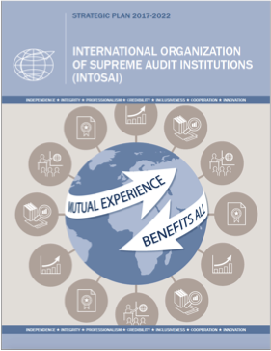
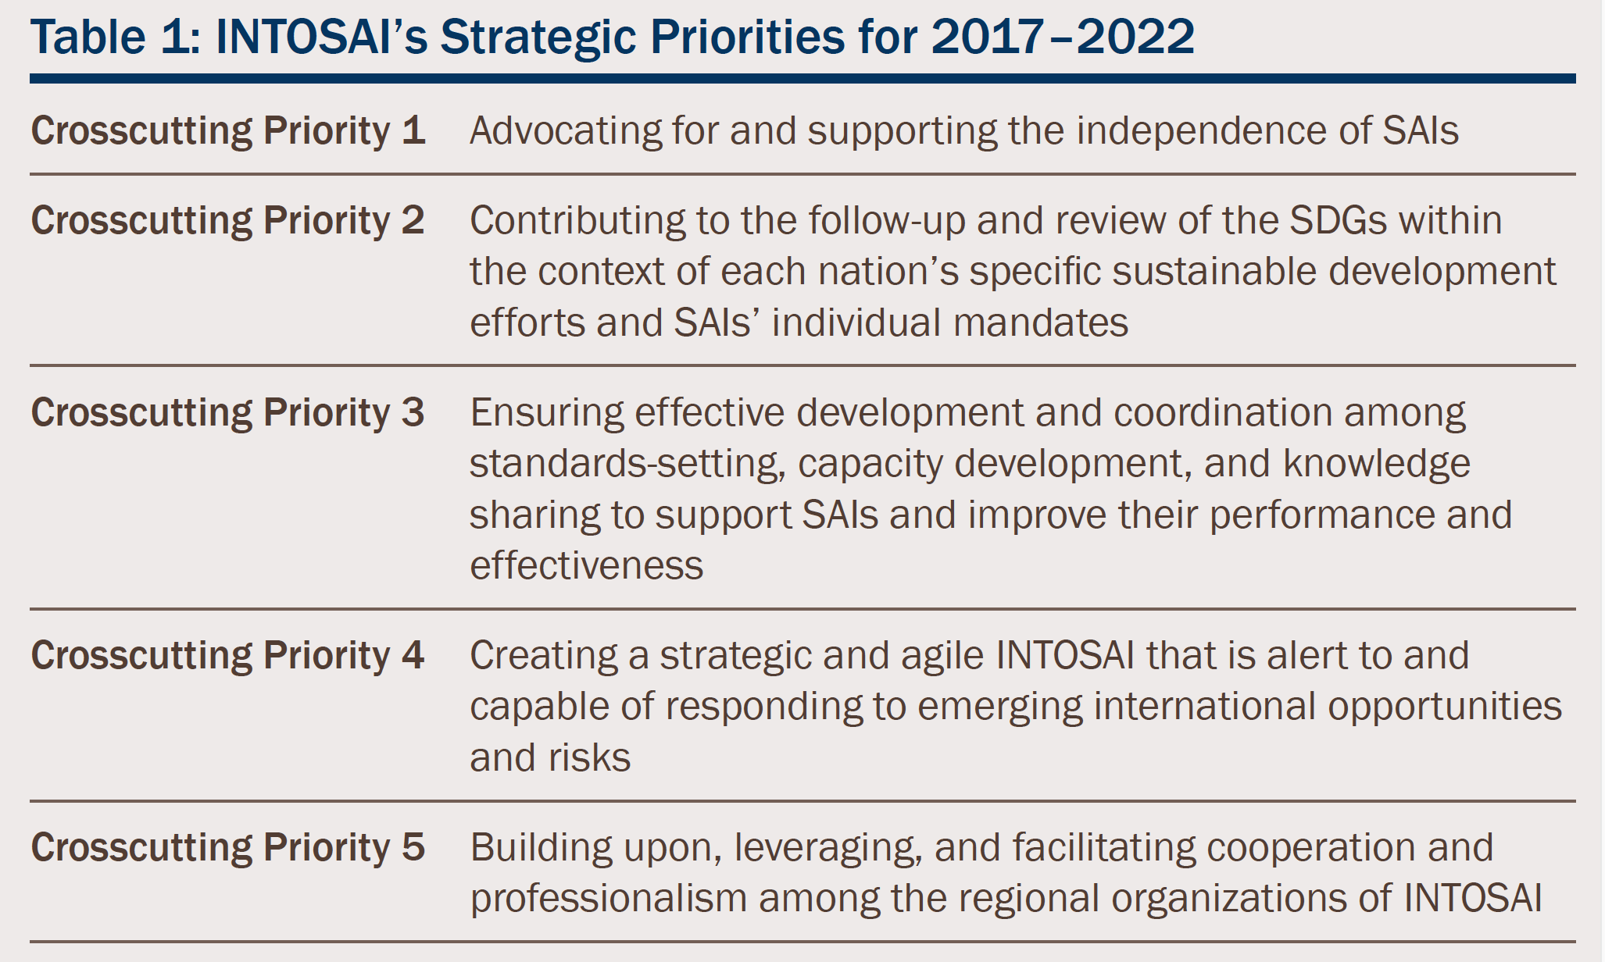
XXII INCOSAI 2016

Slide 3
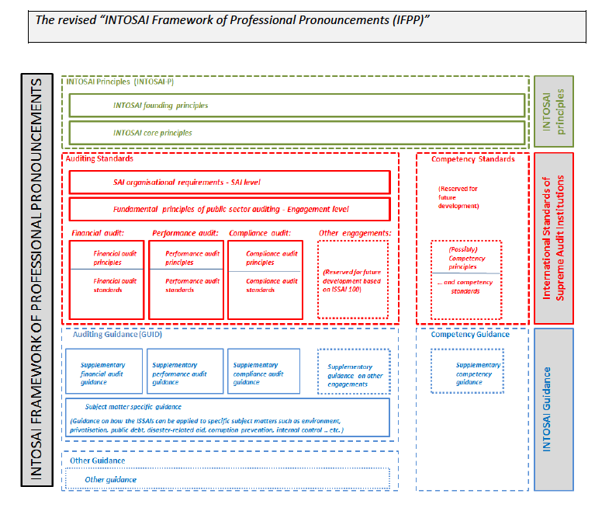
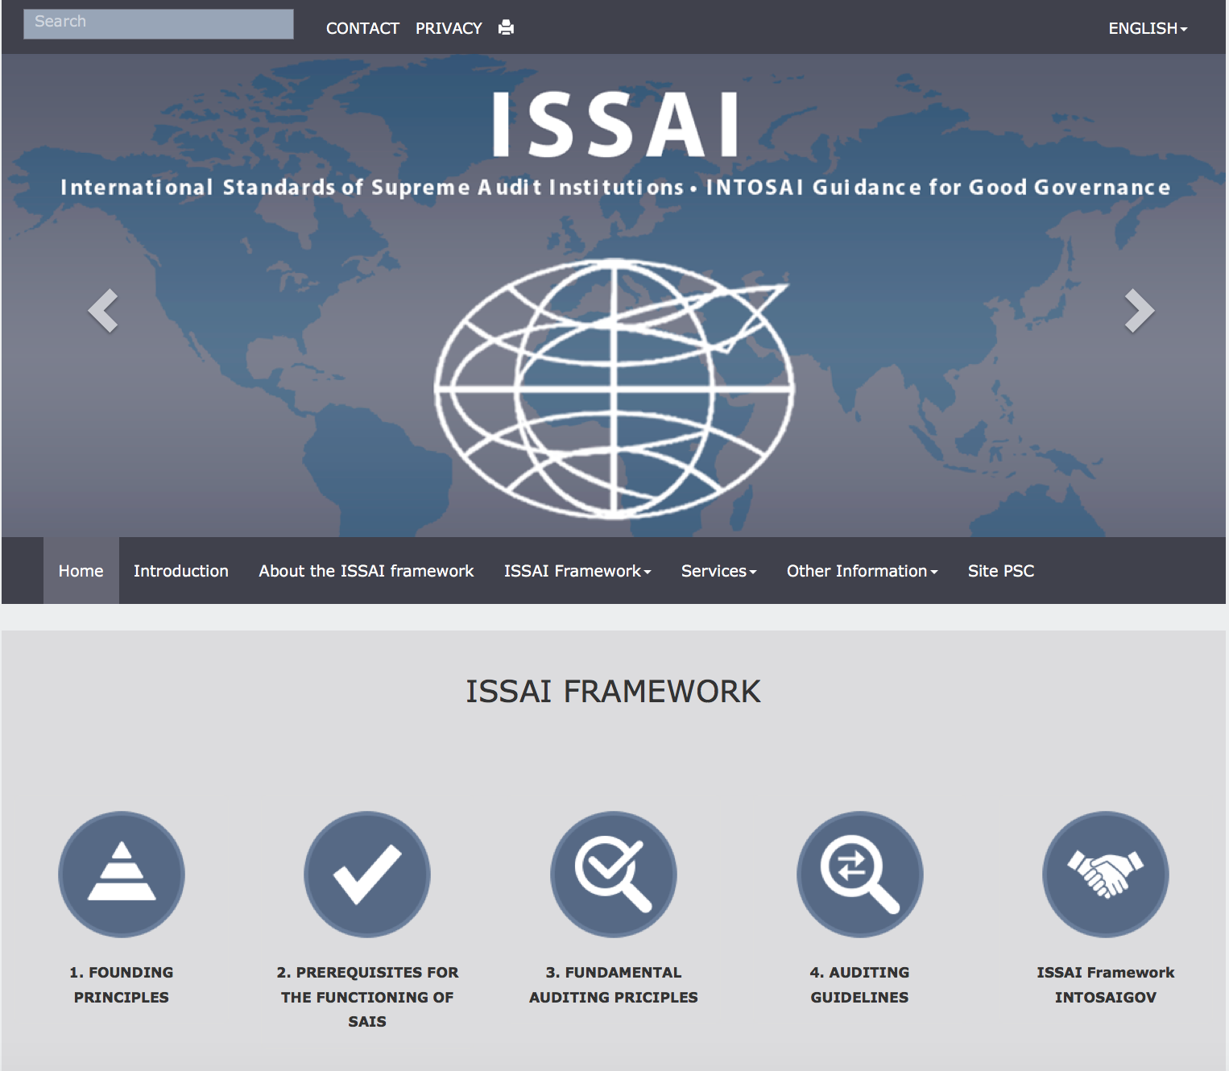
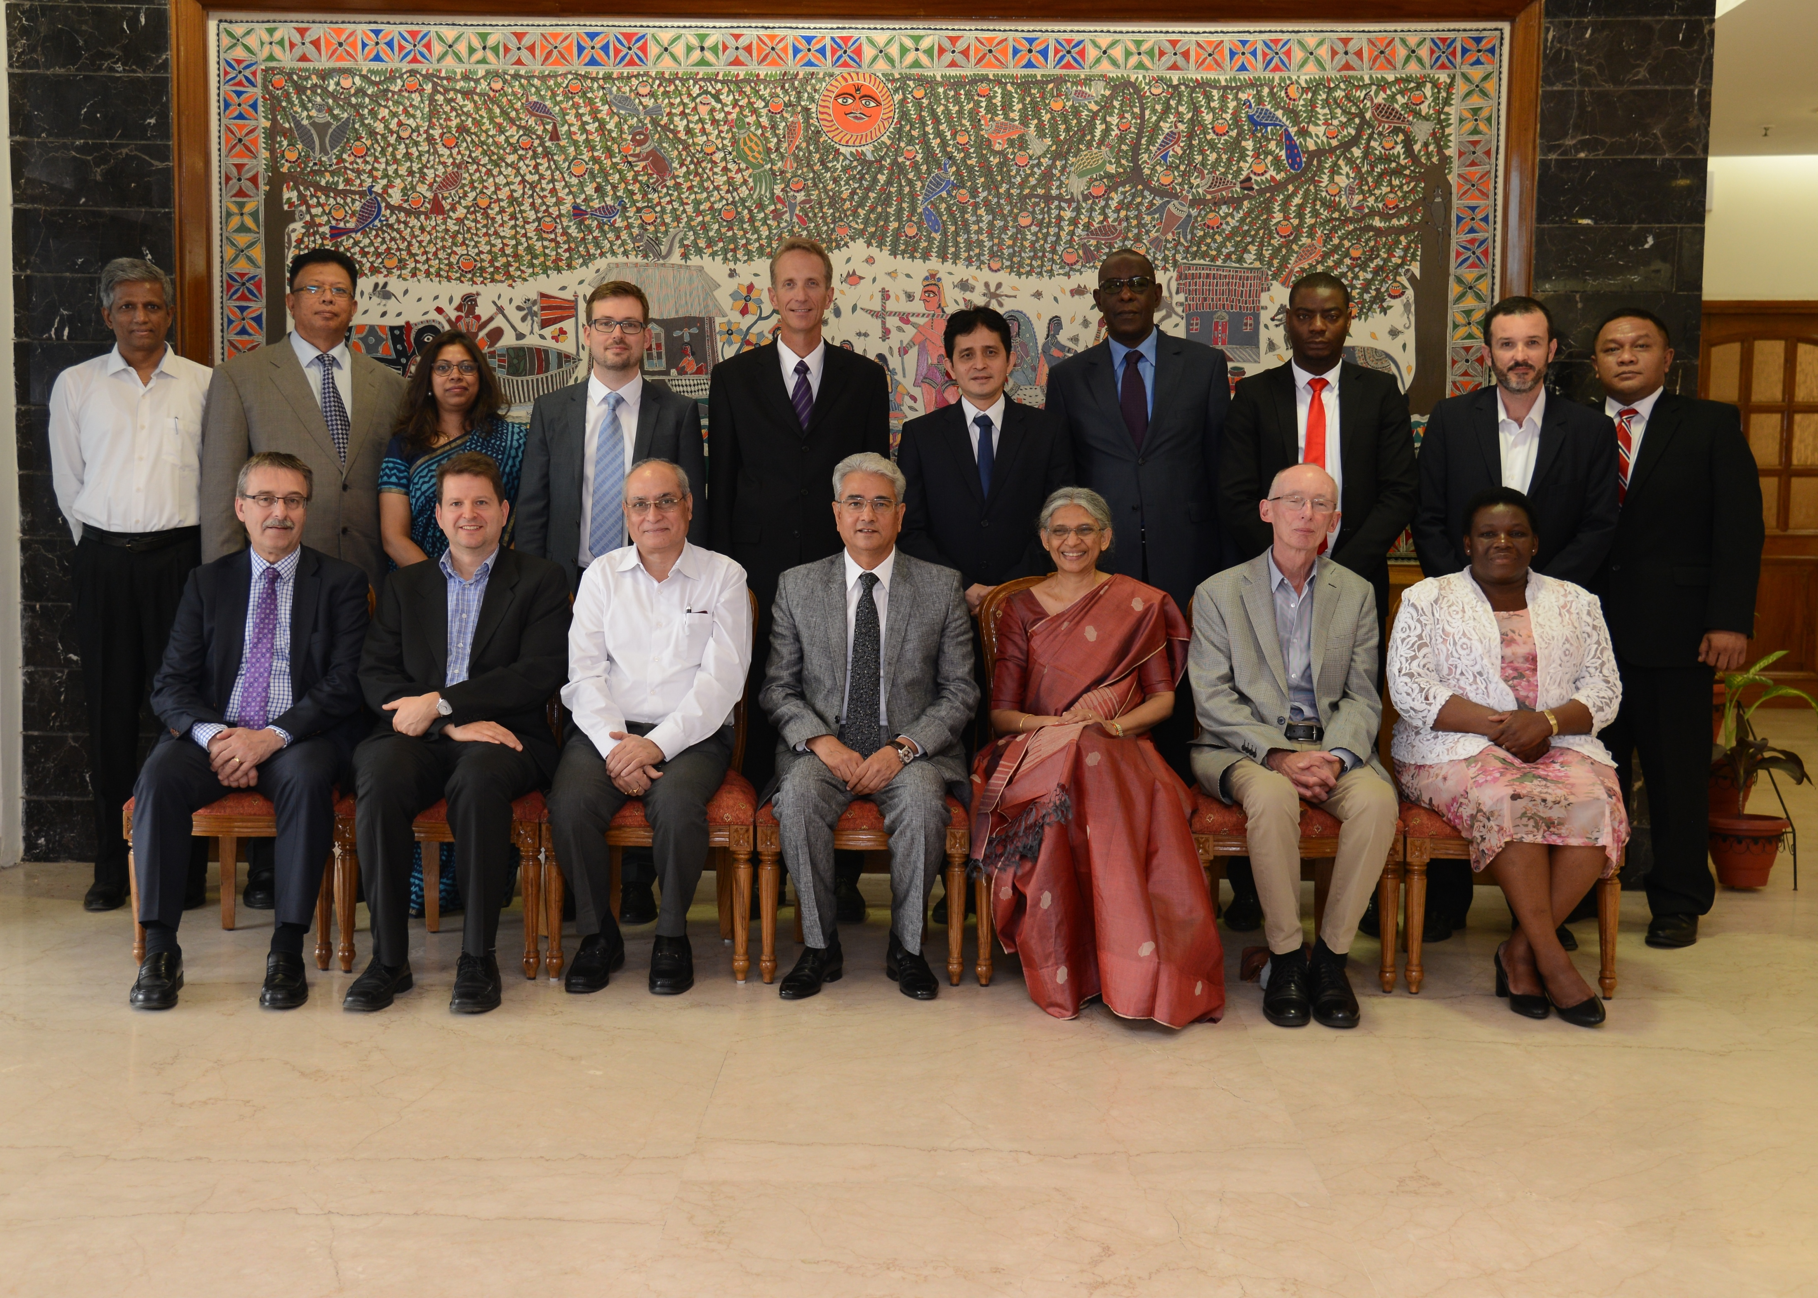
XXII INCOSAI 2016
INTOSAI Framework for Professional Pronouncements
(IFPP)
Forum for INTOSAI Professional Pronouncements (FIPP)
INTOSAI Principles
INTOSAI Standards
INTOSAI Guidelines

Slide 4
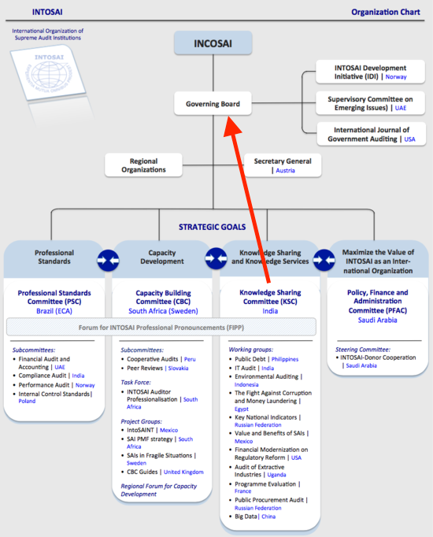
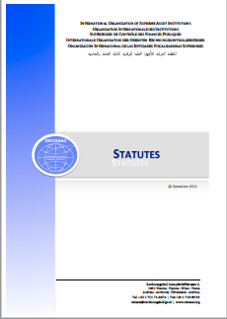
XXII INCOSAI 2016

Slide 5
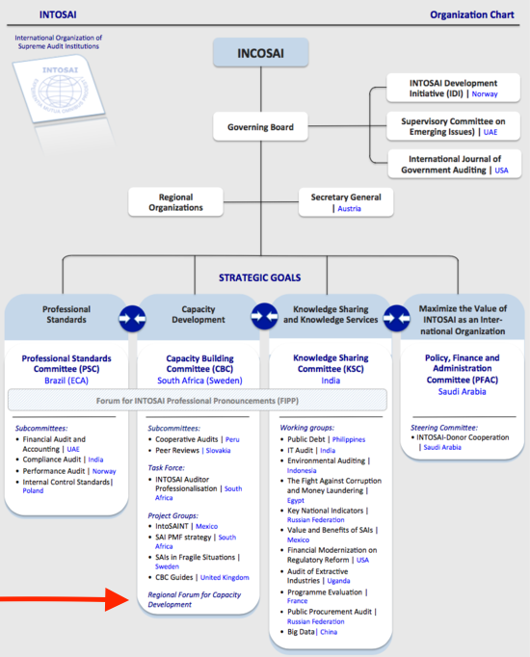
XXII INCOSAI 2016
Regional Forum for Capacity Development

Slide 6
XXII INCOSAI 2016
Priority Theme 2017
„Implementation of the INTOSAI Strategic Plan 2017 – 2022
based on the Abu Dhabi Declaration, with particular focus on
the 5 strategic cross-cutting priorities.“

Slide 7
UN Sustainable Development Goals

Slide 8
UN Sustainable Development Goals
4
approaches:
Auditing national systems of follow-up;
Performance audit of SDG programmes;
Assessing and supporting SDG 16;
Being models of transparency and accountability.

Slide 9
UN Sustainable Development Goals
Measures for implementation:
Auditing preparedness model;
Audit findings framework;
Public financial management framework;
Global SAI performance evaluation framework.

Slide 10
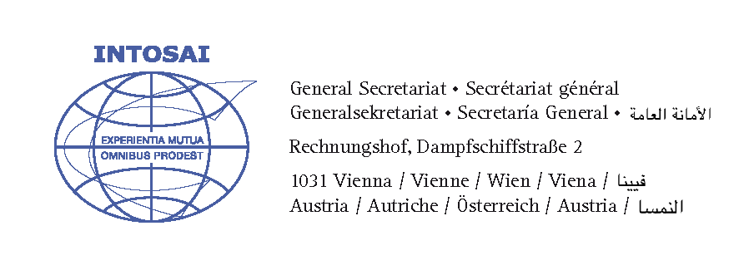
UN Sustainable Development Goals
Foster substantive discussions and knowledge-sharing on critical issues

Slide 11
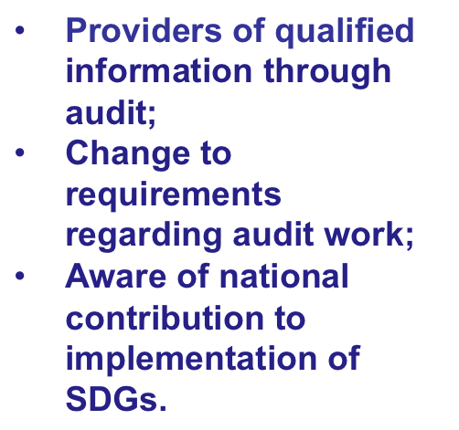
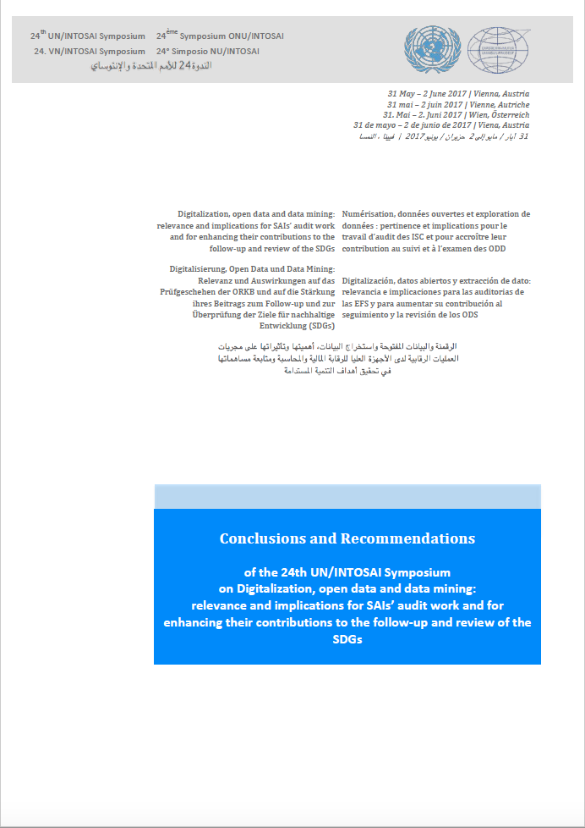
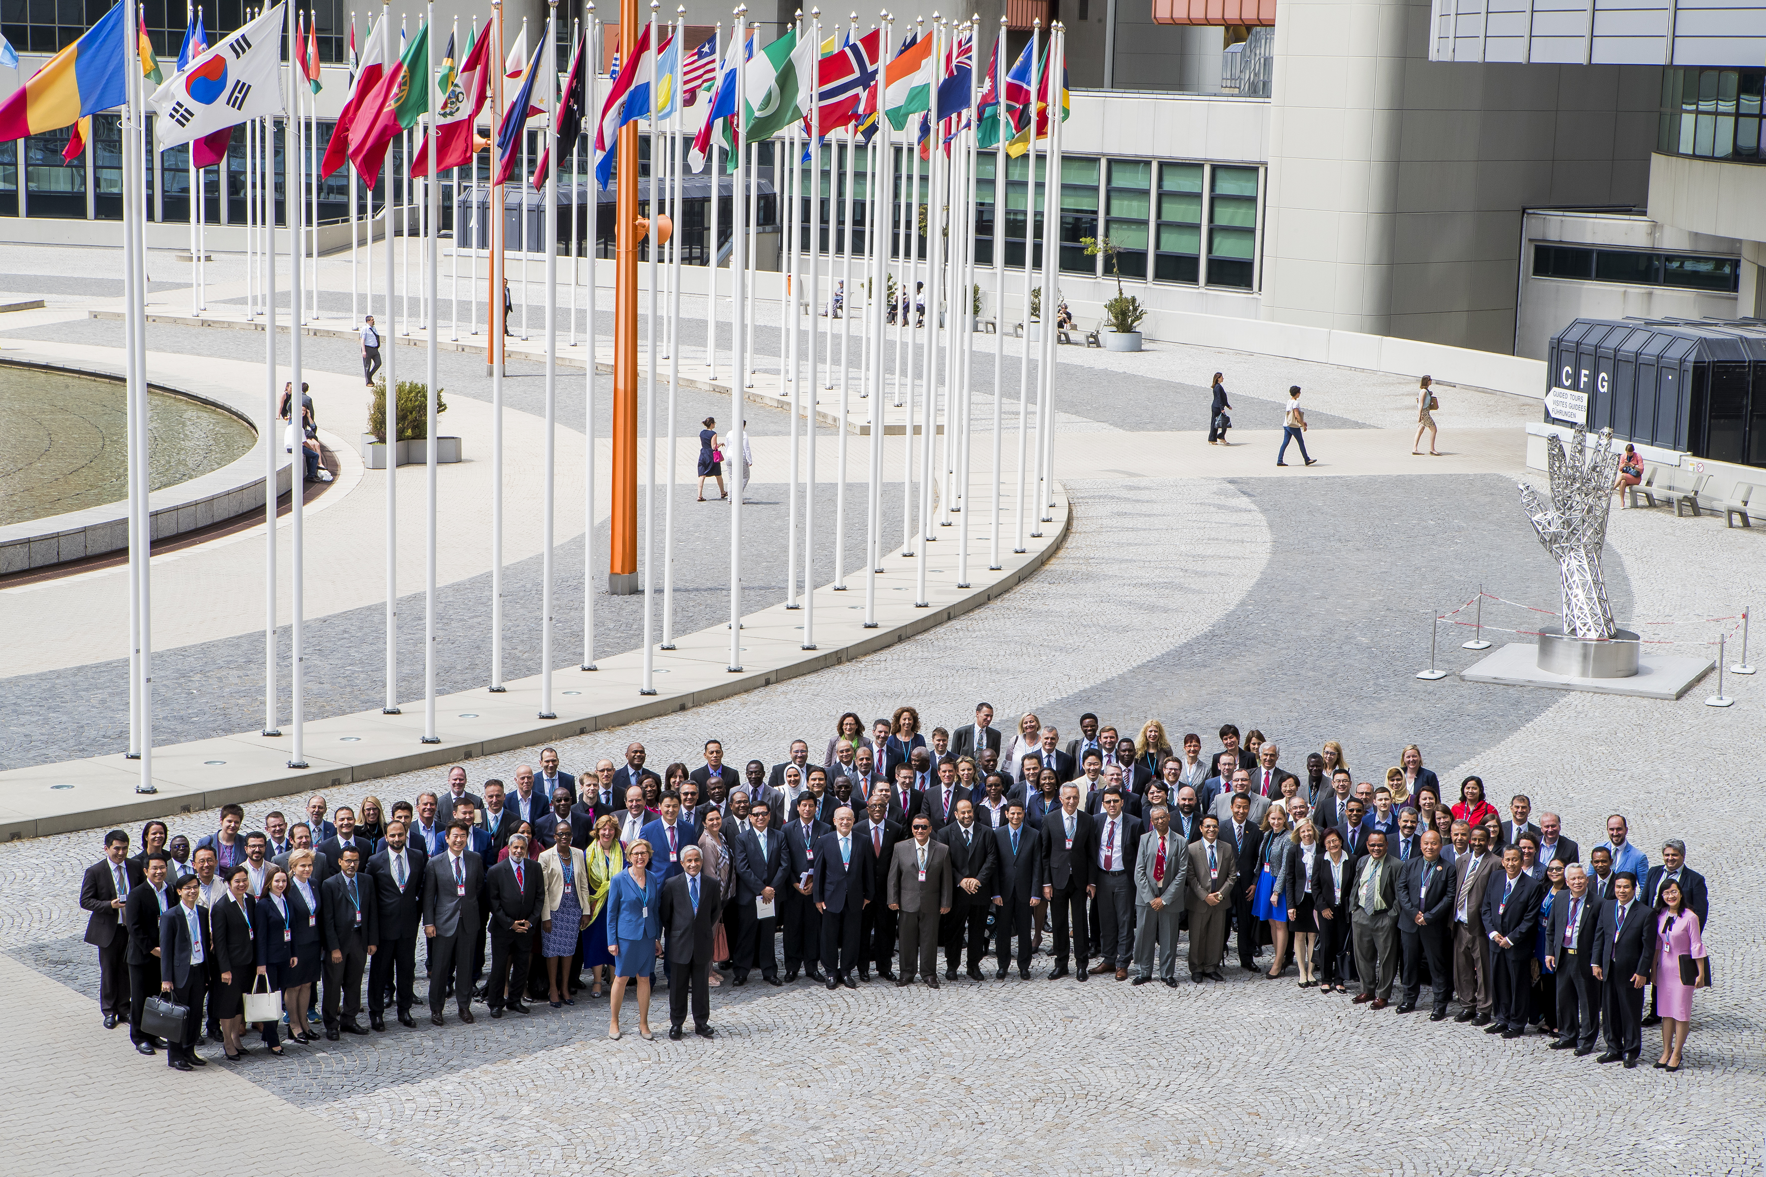
24th UN/INTOSAI Symposium 2017
Digitalization, open data and data mining: relevance and implications for SAIs’ audit work and for enhancing their contributions to the follow-up and review of the SDGs.”

Slide 12
XXIII INCOSAI 2019
Sub-theme I.1:
Data-quality and indicators for public sector development
Theme I:
Information technologies for the development and raising efficiency within the public sector
Sub-theme I.2:
The place and the role of formed data and big data obtained in the activity of SAIs

Slide 13
XXIII INCOSAI 2019
Sub-theme II.1:
The strategic audit as a tool of the SAIs to assess the potential and results of the goals achieved in the social and economic spheres
Theme II:
The role of SAIs in the achievement of their strategic goals and priorities
Sub-theme II.2:
The role of SAI and INTOSAI in securing openness of economics and in resolving tasks to achieve socially oriented development under prevailing conditions

Slide 14
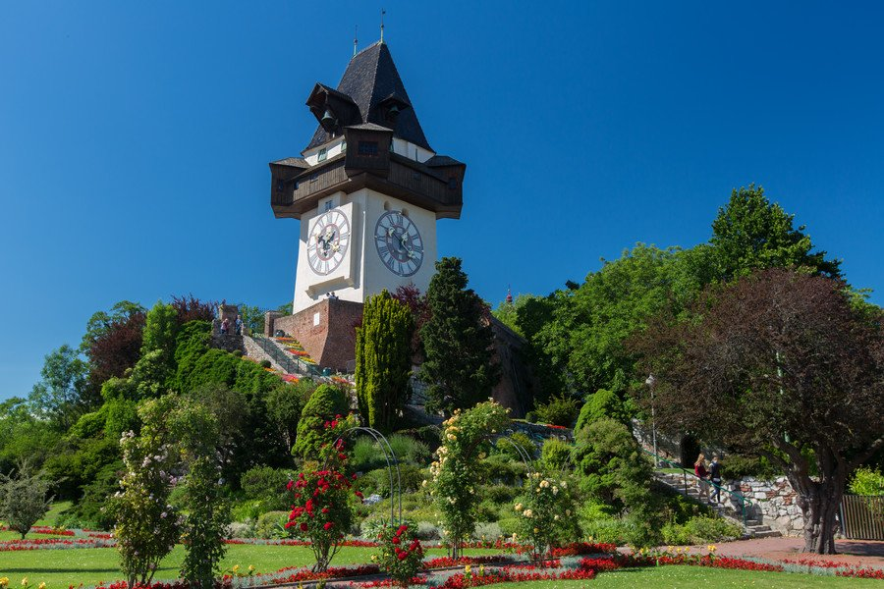
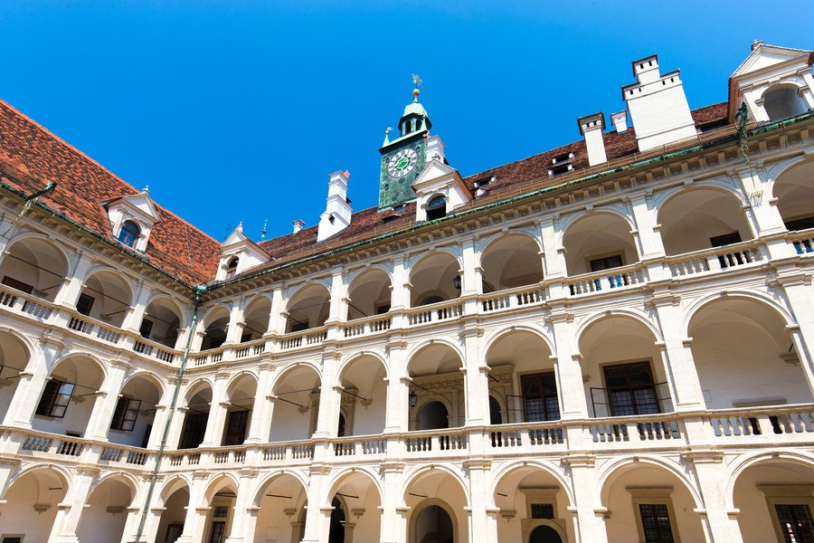
70th Governing Board Meeting 2017

Slide 15
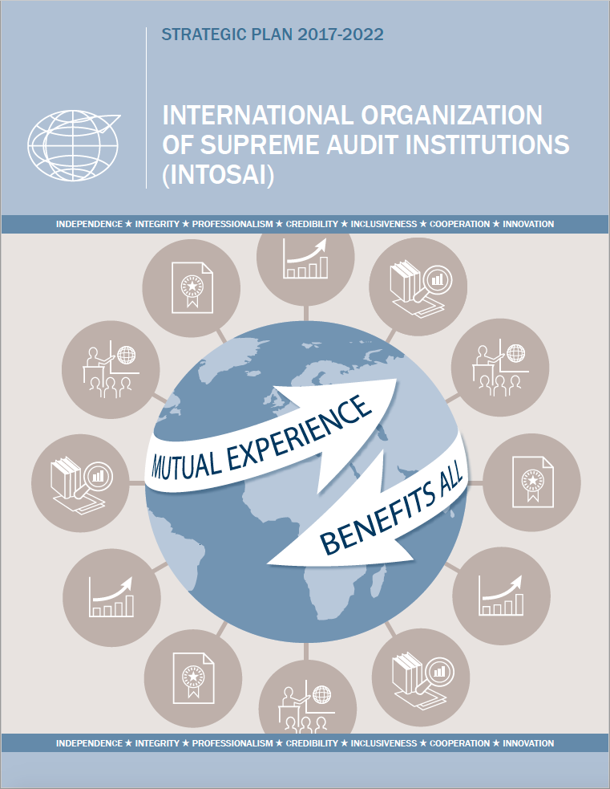
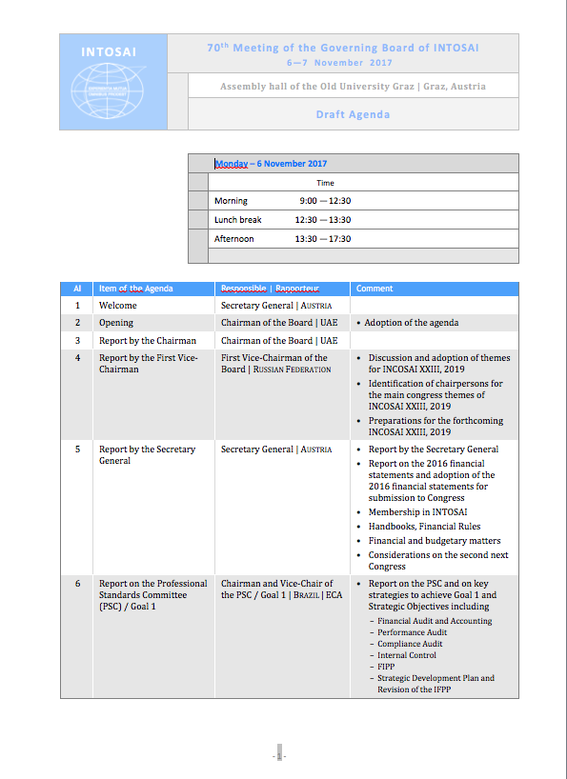
70th Governing Board Meeting 2017

Slide 16
Thank you!

