Slide 1
Annual Report of the Chair of the INTOSAI Working Group on Big Data (WGBD)
QIN YE Secretariat of WGBD National Audit Office of the People&amp;apos;s Republic of China

Slide 2
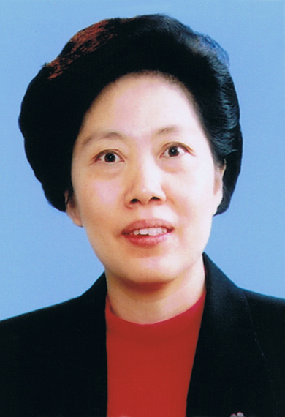
Ms. Hu Zejun was appointed Auditor General of the China National Audit Office (CNAO)
by the Standing Committee of the National People’s Congress Thursday, April 27, 2017.

Slide 3
Establishment of WGBD
68th meeting of the INTOSAI Governing Board approved the motion for the establishment of a new Working Group on Big Data, December 2016, in Abu Dhabi, UAE
SAI China as its chair, SAI U.S. as its vice chair
The XXII INCOSAI endorsed the motion
WGBD listed under Goal 3 - Knowledge Sharing Committee

Slide 4
Working Group on Big Data(WGBD)
Its objective is to identify the challenges and opportunities faced by SAIs in the era of big data; to summarize the knowledge and experience in the field of big data audit; and strengthen relevant bilateral and multilateral technical cooperation.

Slide 5
WGBD
Chair
Vice Chair
Members:
New Member
Observer,
China
United States
Austria, Bangladesh, Bhutan, Brazil, Denmark, Ecuador, Finland, India, Indonesia, Mexico, the Netherlands, New Zealand, Norway, Pakistan, the Russian Federation, Thailand and the United Kingdom.
Fiji
Estonia

Slide 6
S

Slide 7
Group photo of the first meeting of the WGBD

Slide 8
Strategic Goals of WGBD
1.
2.
Identify opportunities and challenges SAIs are facing in a big data world to make recommendations to SAIs.
Summarize the know-how, experiences and good practices concerning big data audit to help SAIs boost relevant skills.
3.
4.
Develop guidelines and research reports to share knowledge and support capacity building activities in big data audit.
Strengthen bilateral, regional and INTOSAI-wide cooperation among SAIs in big data audit.

Slide 9
2017-2019 Work Plan
Symposiums & Meetings
Forums and symposiums
--- Forum on “Challenges and Opportunities Faced by SAIs in a Big Data World” (2017)
--- Symposium on “How Practices of Big Data and Audit Help Promote Sustainable Development” (2018)
--- Symposium on “Changes in Audit Management in the Era of Big Data” (2019)
Annual meeting of the WGBD
Research & Publications
Communications

Slide 10
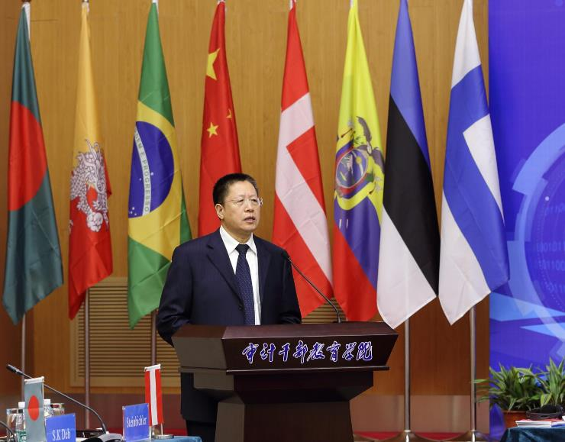
High-level Forum
Five aspects in promoting big data assisted audit:
- accountability
- systemic approach
- data-based approach
- innovation
- human resources
Three proposals:
- work hand in hand
- push forward with aspiration and courage
- develop practical and rational plans
Dr. Sun Baohou
Deputy Auditor General of CNAO

Slide 11
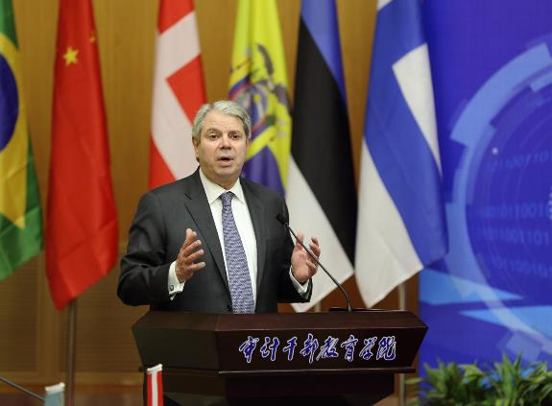
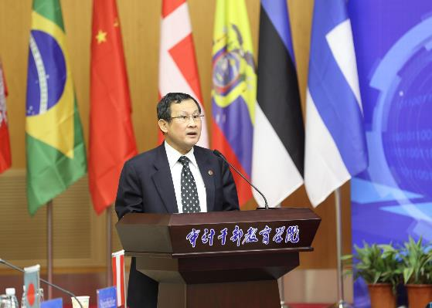
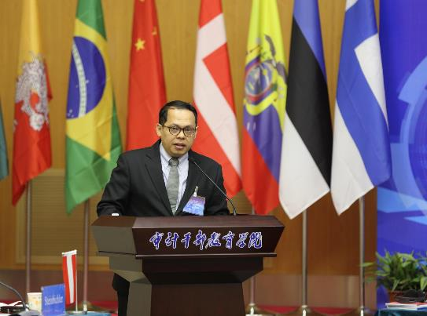
High-level Forum
Mr. Gene Dodaro
Vice Chair of WGBD
Comptroller General of the U.S.
Mr. Agus Joko Pramono lBoard Member of the Audit Board of Indonesia
Prof. Chaisit
Chairman of State Audit Commission of Thailand

Slide 12
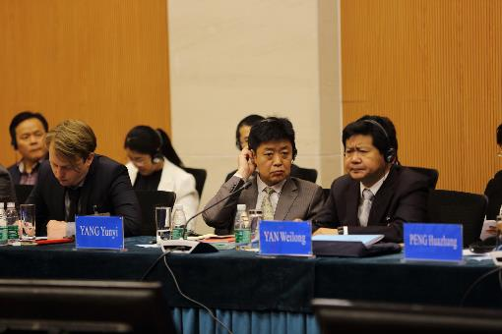
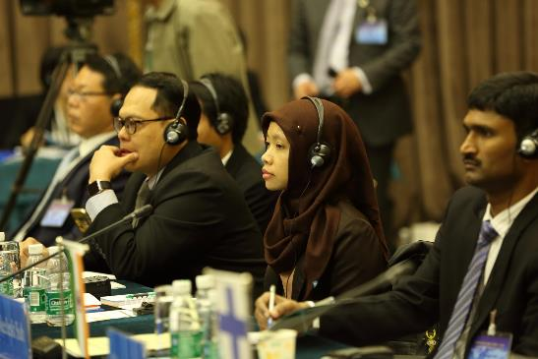
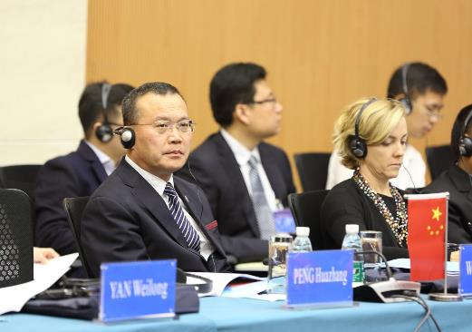
13 SAIs shared practices and experiences
Austria
Brazil
Ecuador
Estonia
Denmark
Finland
India
Indonesia
Norway
Russia
Thailand
UK
China

Slide 13
Main points of view
National policies should support the work of government auditors
Avariety of big data technologies should be applied
IT infrastructure construction is critical

Slide 14
List of Research Topics
Basic framework of big data auditing theory
Auditing technologies innovation
Auditing management revolution
Big data auditing practice

Slide 15
Online Survey on Research Topics
Topics | To be leader | To participate
Basic framework of big data auditing theory |  | Finland
Auditing technologies innovation | Indonesia Ecuador | Austria, Norway, Denmark, United Kingdom, Brazil, Russian
Auditing management revolution |  | Brazil
Big data auditing practice | Mexico | Thailand, Indonesia, United Kingdom, Estonia, Russian

Slide 16
Research on
Auditing technologies innovation
Big data auditing practice

Slide 17
Social media

Slide 18
Web Site
www.audit.gov.cn/WGBD

Slide 19
Thank You
Email : intosai-wgbd@audit.gov.cn

