Slide 1
INTOSAI Community Portal
KSC Chair

Slide 2
INTOSAI Community Portal www.intosaicommunity.net or www.intosaiportal.org
Initiative of KSC and IDI
Single window on the activities of KSC & its 11 Working Groups
Main features
Register on the portal
Request a video conference
Write a blog
Start a chat
Particpate in Community of Practice
Article for Library
Post an exposure draft
Post an event in the Calendar
Post a video/ photo

Slide 3
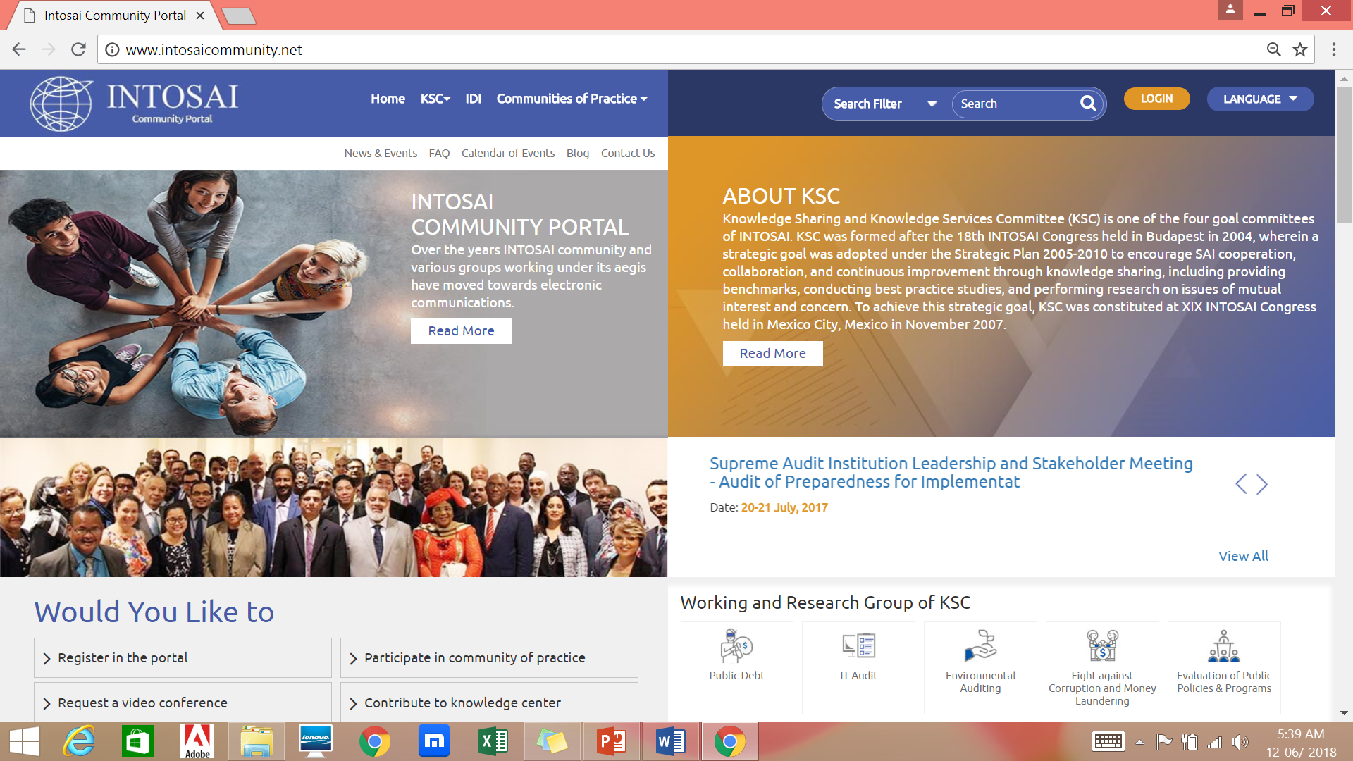
INTOSAI Community Portal (www.intosaicommunity.net or www.intosaiportal.org )
Central repository of information
Information on Working Groups
Separate page for SCEI
Hosts Communities of Practice (closed groups) to facilitate virtual meetings
Provision for polls, surveys, news
Exposure Drafts

Slide 4
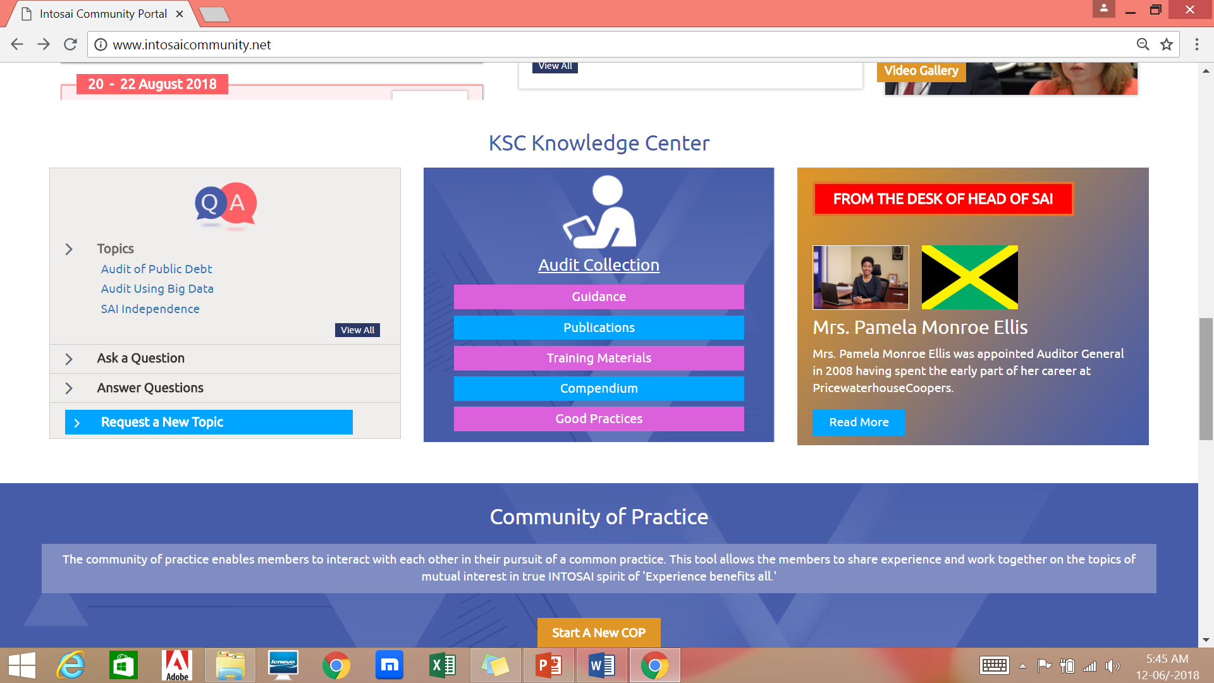
Auditor Centric
To cater to needs of field practitioner of public auditing
Knowledge Centre: access to guidance, compendiums and best practices all around the world
Provision for Q & A: auditors may seek and provide answers on different areas of public auditing

Slide 5
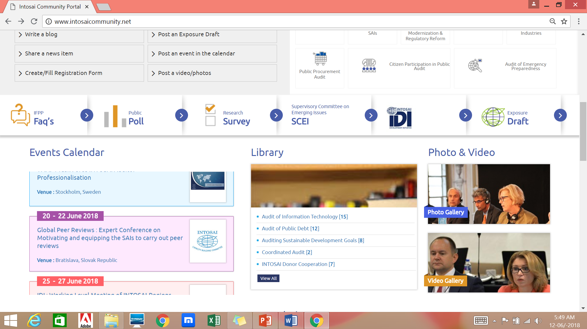
Additional features
Multilingual support– all INTOSAI languages
In- built video conference facility and recording of virtual meetings
Multiple Chat forums
A page for Head of SAI

Slide 6
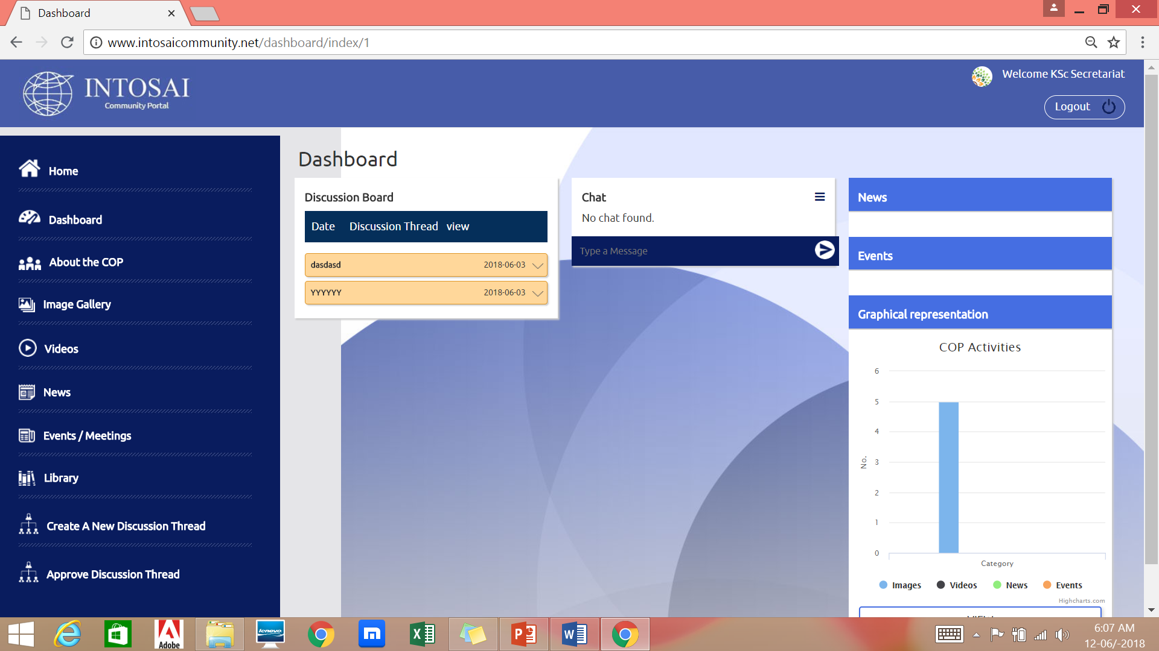
Communities of Practice (CoP)
A Closed group
Will enable members to communicate among themselves and share documents, photos, videos within the group
Two categories of users: Manager and members
Library in CoP keeps track of version changes of documents

Slide 7
Communities of Practice
Manager
Add/delete members, documents, videos and photos
Create different discussion threads for members to interact
Monitor level of participation of members of the group
Members
Add documents, post videos, photos
Chat within discussion threads

Slide 8
Administration of Portal
Overall administration/maintenance by KSC secretariat
Working Groups allotted separate pages enabling adding of additional features/menus
IDI responsible for outreach support
Currently in testing phase (beta version)

Slide 9
Some questions for further cooperation
Ways to get the Regions’ support in promotion of the Portal as central repository of information?
Should we register a focal point for each INTOSAI body for contributing documents etc. for the library?
How do we use the Portal for better synergies and for enhancing the region-to-region knowledge sharing?
How do we go about the translation in other languages?
How do we use the Portal for the INTOSAI-Regions Cooperation Platform?
Suggestions on improvement may be sent to ir@cag.gov.in

Slide 10
THANK YOU

