Slide 1
SAIs making a difference by Auditing SDGs

Slide 2
Key Messages
Why is Auditing SDGs important ?
What is different about Auditing SDGs
IDI- KSC Auditing SDGs Programme
Key Messages & Future Plans

Slide 3
Why is it important for SAIs to contribute to implementation of SDGs ?
Implementation of Agenda 2030 will improve the lives of citizens
SAIs have a central role to play in an independent oversight of the implementation of the agenda
SAIs need capacity to conduct high quality audits of implementation of SDGs so that they contribute to value and benefits for citizens

Slide 4
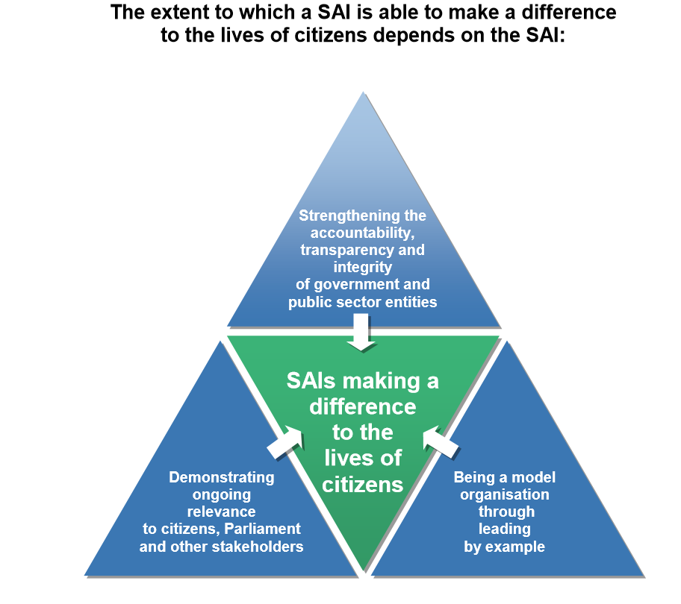
Agenda 2030 & ISSAI 12
All United Nations Members States jointly committed to The Sustainable Development Goals (SDGs) in September 2015.

Slide 5
Key Principles of Agenda 2030
National Ownership
Universal
Integrated
National targets considering national priorities
Relevant for both developed and developing countries
Integrate social, economic and environmental aspects in policy making and implementation

Slide 6
Key Principles of Agenda 2030
Leave no one behind
Partnership for Goals
Follow up and Review
Reaching the furthest behind first
Wide stakeholder participation – government, parliament, public institutions, academia, professional bodies, civil society, vulnerable groups, citizens, private sector
SDG Results Targets and indicators
Inclusiveness
Voluntary National Reviews at High Level Political Forum
Partnership for implementation

Slide 7
SDGs & INTOSAI
1
Review or audit preparedness of governments for implementing SDGs
2
Undertake performance audits on specific aspects of SDGs
3
Assessing and supporting the implementation of SDG 16
4
Being Models of transparency and accountability in own operations
INTOSAI SP 2017-2022
Cross-cutting Priority 2
Contributing to the follow-up and review of the SDGs within the context of each nation’s specific sustainable development efforts and SAIs’ individual mandates.

Slide 8
AUDITING SDGs PROGRAMME
Support SAIs in conducting high quality audits of SDGs
Partners : KSC, UNDESA, KNI, INTOSAI Regions, CAAF, IBP, GAB
Advocacy & Awareness Raising
Guidance on Performance Audit of Preparedness for Implementation of SDGs
Cooperative Performance Audit of Preparedness for Implementation of SDGs
Lessons Learned and Compendium of Audit findings
Community of Practice of SDG Auditors
Massive Open Online Course on: Leave no one Behind

Slide 9
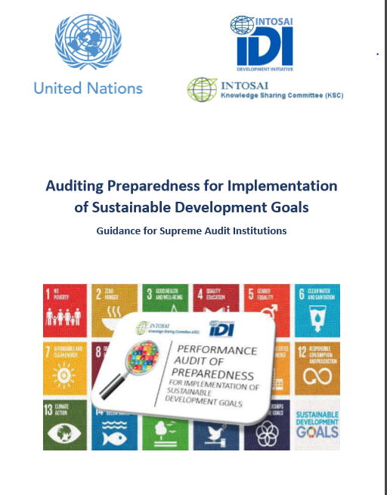
Guidance on Performance Audit of Preparedness for Implementation of SDGs
To be finalised in 2018 based on IDI’s protocol for GPGs and experience from learning programmes.
Current version available on IDI website
IDI to publicly expose version 0

Slide 10
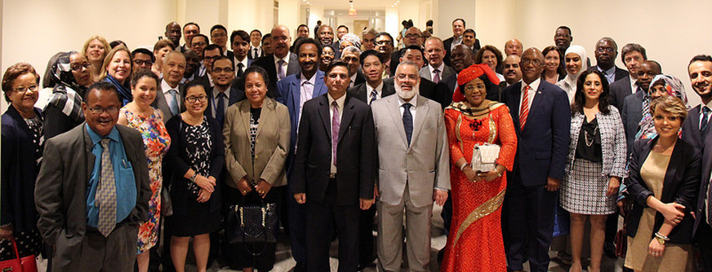
Advocacy & Awareness Raising
UN-IDI Meetings for SAI Leadership and Stakeholders 2017, 2018, 2019
Regional workshops of SAI Leadership and Stakeholders – CREFIAF ( 7-9 Feb 2018), ARABOSAI (2019)
IDI presentations at different forums

Slide 11
73 SAIs and 1 sub national office in English speaking regions, CREFIAF & OLACEFS
EUROSAI: 3 SAIs
ASOSAI : 15 SAIs
ARABOSAI (*)
CAROSAI: 2 SAIs
CREFIAF 16 SAIs
OLACEFS: 15 SAIs + SAI Spain
Auditing Prep for implementation of SDG 5
PASAI : 13 SAIs
AFROSAI-E: 8 SAIs
(*) Programme to be rolled out in ARABOSAI in 2019

Slide 12
What is different in Auditing SDGs ?
1. Integration - Whole of Government Approach
2. Inclusiveness - Leave No one Behind
3. Follow up and Review - Data
4. Multi stakeholder engagement

Slide 13
Why audit preparedness?
- Urging national governments into action if there isn’t any
- Providing constructive feedback at an early stage
- Reminding governments that SDGs are not business as usual by looking at issues of integration, coherence, coordination and inclusiveness
- Contribute by providing independent oversight on preparedness
- Going in at this stage will also enable the SAIs to know all the stakeholders and negotiate a more central position for themselves in their countries efforts towards implementing SDGs.

Slide 14
Auditing Preparedness ‘entire agenda’
Gap Analysis
Strategy
Institutional Arrangements for integration in national context
Arrangements for means of implementation
Arrangements for follow-up and review
Whole of Government, Inclusiveness,
Multi-stakeholder engagement

Slide 15
Performance Audit of Preparedness for Implementation of SDGs
Audit Objective 1 – To what extent has the government adapted the 2030 agenda into its national context?
Audit Objective 2 – Has the government identified and secured resources and capacities (means of implementation) needed to implement the 2030 Agenda?
Audit Objective 3 – Has the Government established a mechanism to monitor, follow-up, review and report on the progress towards the implementation of the 2030 Agenda?

Slide 16
Cooperative Audit support model
Middle level management involved in the audit process
Guidance on Auditing Preparedness
Agenda 2030
SAIs and SDGS
Audit Model
Performance Audit of Preparedness
eLearning/ face to face workshop
1-2 week mentor training
8 week mentor led eLearning course/two week workshop for audit teams on subject matter & methodology
Support during the audit process
Audit
Planning Meeting
Audit Review Meeting
Quality Assurance
Independent assurance of audit quality
SAI Commitment and Readiness
SAI includes the audit in their annual plan
Readiness to provide resources and to conduct the audit
Agreement with SAI leadership
Participation of middle management
SAIs contribute to value & benefits through independent oversight and constructive recommendations
SAIs have a voice in the SDG implementation in their countries and are not left behind
SAIs develop capacity to conduct PAs on SDGs
Onsite/online support during audit
Notes:
Audit Report Review Meeting postpo

Slide 17
Lessons Learned and Compendium of Audit Findings
To be developed in a phased approach due to different pace in audit processes
Based on a common reporting framework
Try to include as many published SAI audits as possible
To be published in time for HLPF 2019

Slide 18
Massive Open Online Course – Leave no one behind
Move from preparedness to implementation
For SAI Management and audit teams
High level interaction using gaming formats
Awareness raising & practical how to guidance
Based on IDI eLearning methodology, use IDI LMS
Available to anyone at anytime
Initially developed in English, to explore other language options
Partnership with KSC, UNDESA inputs from global team
Avoid duplication
To leave no one behind in auditing SDGs
Notes:
IDI will start developing SDG MOOC in 2019, instead of 2018.

Slide 19
Key Messages
To begin with focus on ‘preparedness’ not ‘implementation’ across ‘entire agenda’
Advocate SAI role
Participate in VNRs , conversations with key national actors, visibility of the audit effort
Recognise what is different in Auditing Agenda 2030
SAI Leadership to determine SAI’s strategic direction in engaging with SDGs
Consider ‘whole of government approach’ to auditing SDGs
Cannot audit SDGs without considering inclusiveness
High quality audits as per ISSAIs
Engage widely with national and international stakeholders throughout the audit process
Stakeholders expect SAIs to go beyond traditional financial/compliance audits to look at performance

Slide 20
As we embark on this great collective journey, we pledge that no one will be left behind. Recognizing that the dignity of the human person is fundamental, we wish to see the Goals and targets met for all nations and peoples and for all segments of society. And we will endeavour to reach the furthest behind first.

Slide 21
Strategic Process
What is your vision ?
Where do you want to go ?
Strategic options, risks, capacities required
Implementation of strategy
Where are you ?
Gap Analysis
SAI PMF
Government
SAI

Slide 22
SAI Capacity
Cross-cutting Priorities
SAI Institutional Capacity
SAI Organisation Systems + Professional Staff Capacity
SAI Contribution to Impact
SAI Outputs
SAI Outcomes
SAI culture + leadership; inclusiveness + gender
Well-Governed SAIs Work Stream
Public confidence in the SAI
B
accountability reporting
Independent SAIs Work Stream
Internal governance and ethics +
A
Audit reports scrutinized & recommendations implemented
Independence + legal framework
C
SAI core services planned and delivered ensuring relevance of subject matter and approach
ISSAI compliant FA practice + audit results
Professional & Relevant SAIs Work Streams
Public confidence in government financial systems
ISSAI compliant PA practice + audit results
SAIs making a difference in the quality of public sector governance and service delivery for the value and benefit of citizens
ISSAI compliant CA practice + audit results
SAI Strategic Management Framework
National progress towards implementation of Agenda 2030 and the SDGs
Judgement process + results
Other core services + results
D
E
Improved compliance with laws and regulations
Corporate services
HRM + Professional staff development
Well-Governed SAIs Work Stream₁
Professional SAIs Work Streams₂
Stakeholder engagement in public budgets & accountability
F
Communication and Stakeholder management, including coordination of support
Cross-cutting Priorities
+ results
Well-Governed SAIs Work Stream₃
Effective, transparent and inclusive national institutions
Country governance, political, social, cultural and public financial management environment
1. Workstream includes support to strategic & operational planning in relation to core corporate services. 2. Workstream includes support to professional auditor development.
3. Workstream includes support to stakeholder analysis as part of strategic planning, and support to developing communication strategies.

Slide 23
Future Plans
Move from programme to workstream
Work on a strategic framework that brings together ISSAI based audit methodology and SDGs
Support audit of implementation of SDGs using WoG
Explore new audit areas related to WoG e.g. data analytics in audit, auditing performance information, auditing inclusiveness
Continue to work with capacity development, knowledge sharing and advocacy related to SDGs

