Slide 1
UGANDA !!!
Host of the 10th Meeting:
Of the Steering Committee of INTOSAI Committee on Knowledge Sharing and Knowledge Services (KSC)
in the city of
Kampala
In Africa 2018
From Bali to Kampala

Slide 2
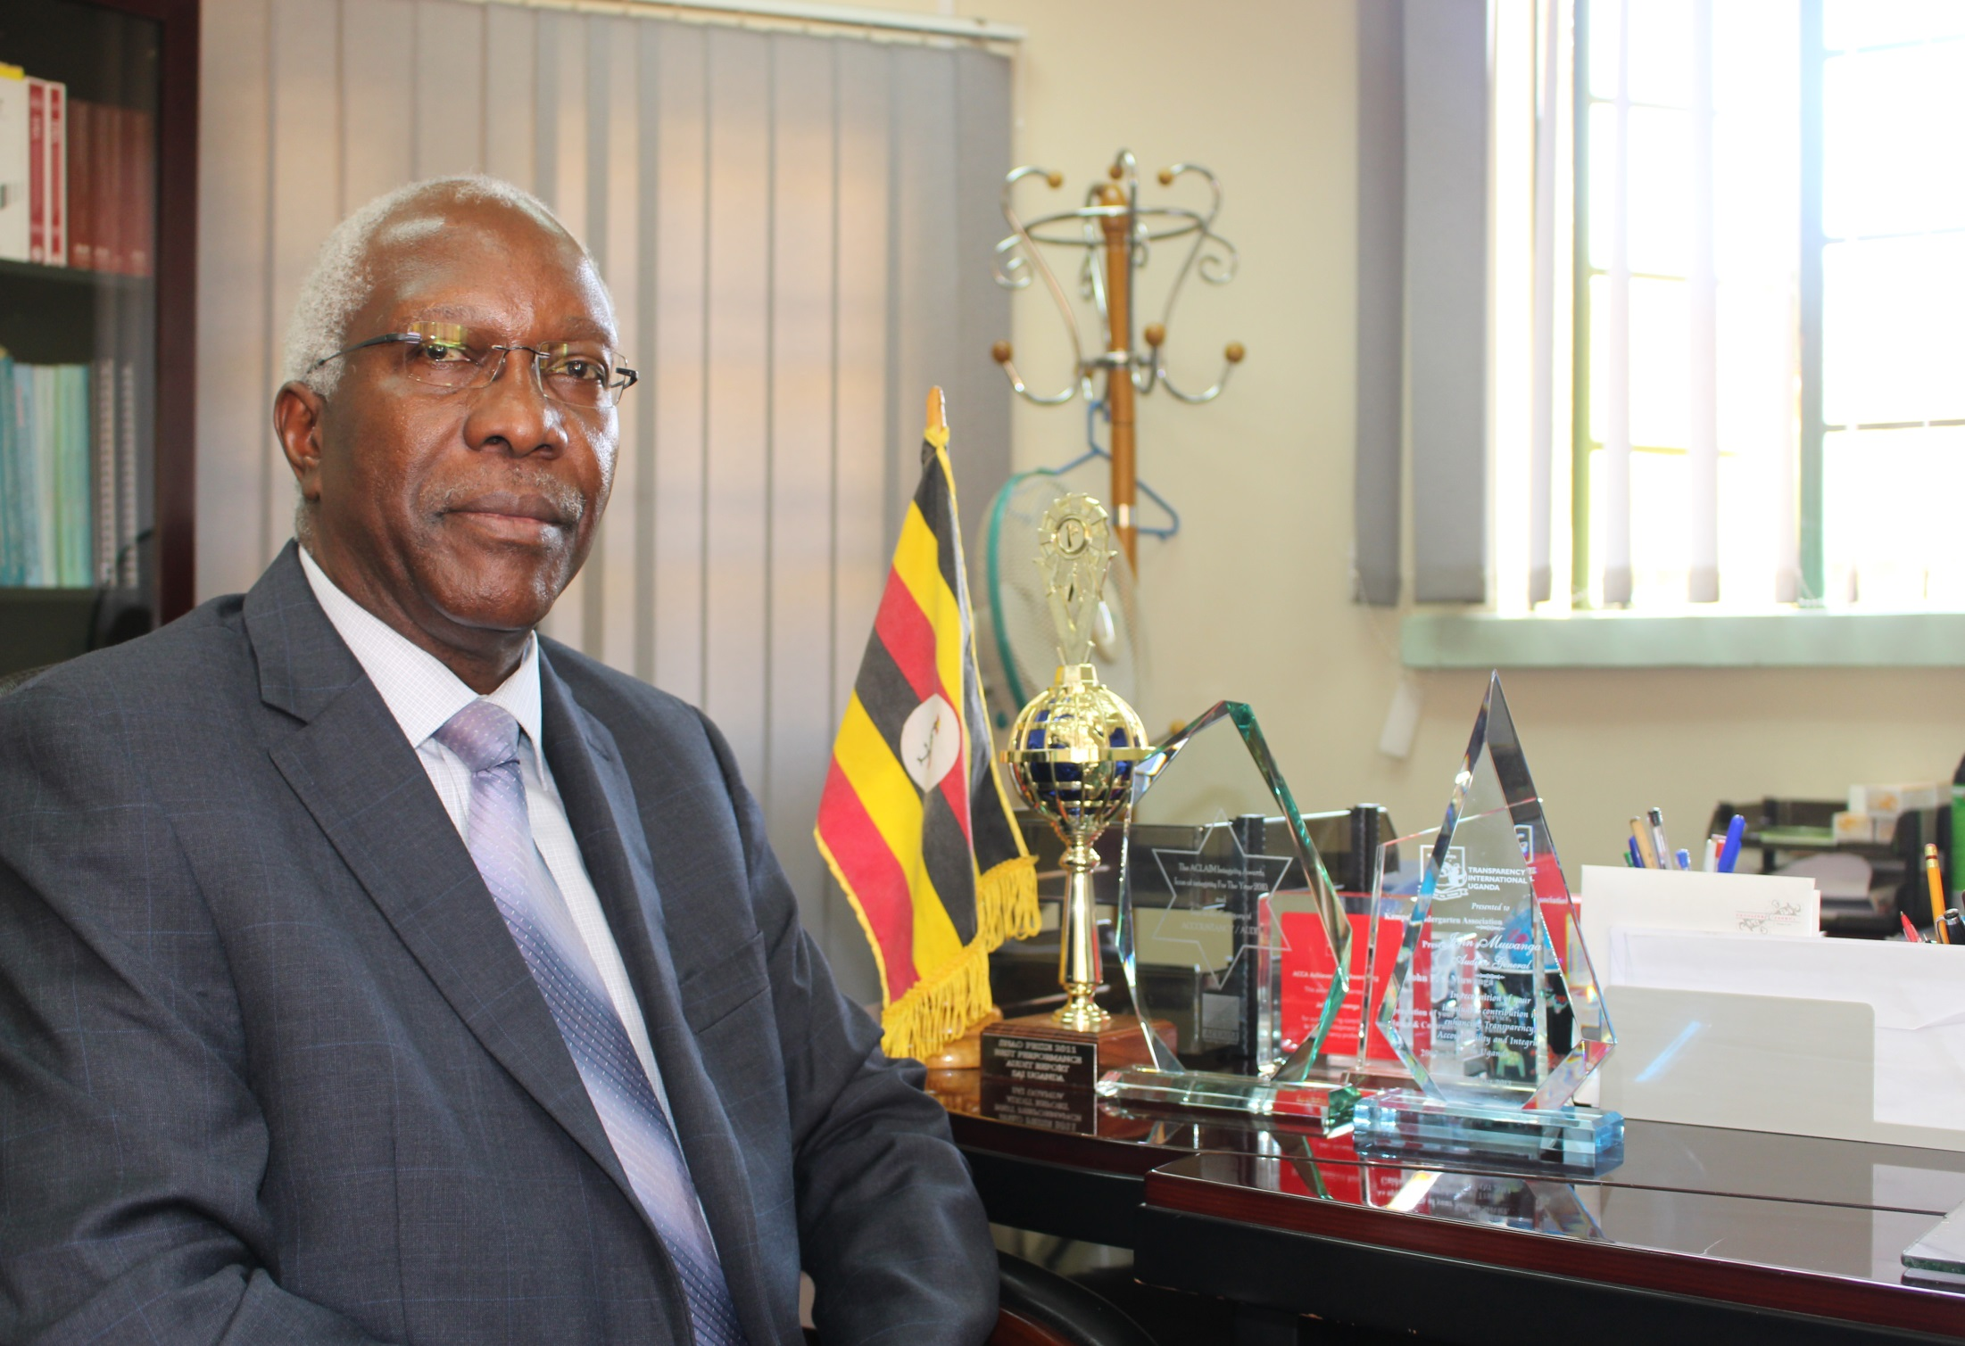

Slide 3
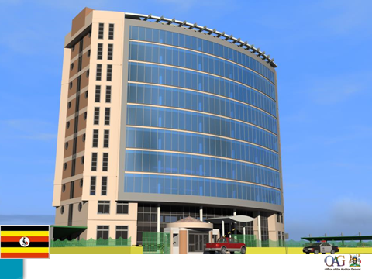
WELCOME TO AUDIT HOUSE- KAMPALA
UGANDA

