Slide 1
WORKING GROUP ON PUBLIC DEBT
CONTRIBUTION TO THE IMPLEMENTATION OF THE STRATEGIC OBJECTIVES AND CROSSCUTTING PRIORITIES
FABRIKAM RESIDENCES
COMMISSION ON AUDIT
Republic of the Philippines
11th ANNUAL MEETING OF THE INTOSAI KSC
12-14 June 2019 | Pampanga, Philippines

Slide 2
ACCOMPLISHMENTS
Development and Utilization of INTOSAI Community Portal
Dissemination of WGPD activities and outputs through COP, INTOSAI Journal, et.al.
Co-branding of IDI’s Handbook on Audit of Public Debt
Approval of the Revised WGPD Terms of Reference by the INTOSAI GB

Slide 3
ACCOMPLISHMENTS
Increased WGPD Membership
Published Exposure Draft of GUID 5250
Development of WGPD Workplan 2020-2022

Slide 4
PROGRESS REPORT
REPORTING DASHBOARD
AS OF 24 MAY 2019

Slide 5
Enhanced Expertise of SAIs in Audit of Public Debt
New INTOSAI products
Project 2.9 GUID on Audit of Public Debt (GUID 5250)
Project on schedule

Slide 6
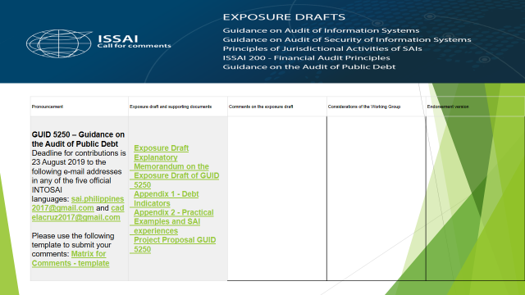

Slide 7
Wider exchange of knowledge and experience among INTOSAI members/other stakeholders
INTOSAI KSC-IDI Community Portal
Utilized the INTOSAI tools (Communities of Practice and other ICT-based mechanisms, such as webinar, videoconferences, etc.) in the conduct of seminars, fora, capacity-building programs and workshops.
No. of products published in all INTOSAI’s official languages (i.e. WG’s website, INTOSAI Journal, INTOSAI website.
Project behind schedule
WGPD Workplan 2020-2022
TBD

Slide 8
Wider exchange of knowledge and experience among INTOSAI members/other stakeholders
Research projects
Concept notes drafted and circulated to WGPD members for comment
Generation and dissemination knowledge and experiences
seminars, fora, capacity-building programs and workshops in collaboration with other parties/stakeholders
WGPD Workplan 2020-2022
TBD

Slide 9
Wider exchange of knowledge and experience among INTOSAI members/other stakeholders
Stakeholder engagement
Developed participation guidelines for the WG’s members
Facilitate continuous improvement
TBD
Cooperate with and leverage the efforts of the International Journal of Government Auditing and the General Secretariat to expand the use of social media, et.al.
Established close coordination with the KSC-IDI, INTOSAI General Secretariat (Website), and US GAO (Journal) for the timely publication of WGPD outputs on public debt auditing issues
Project on schedule
Project on schedule

Slide 10
