Slide 1
AUDITING FOR SUSTAINABLE DEVELOPMENT
Preconditions, the role and the impact of Supreme Audit Institutions in sustainable development
3rd GALF Meeting
Austria, May 23 – May 24 2016
Aroldo Cedraz
President of Tribunal de Contas da União
(Federal Court of Accounts of Brazil)

Slide 2
Let’s begin...
We must recognize the efforts several countries already made in the pursuit of sustainable development
And also the UN's concern to seek the support of control entities to assist nations in achieving the Sustainable Development Goals (SDGs)

Slide 3
We need to ask ourselves
What can we do in order to lead governments to realign public policies towards the achievement of the SDGs?
Which goals must we pursue in the future to remain relevant and keep the positive impact of our actions?

Slide 4
We have come to realize that
Brazilian organizations need to evolve in the adoption of good management practices, as the low quality and failure of public services prevail
Reasons?
Lack of Planning
Unqualified Personnel
Lack of systemic assessments
Bureaucratic Culture

Slide 5
And we are aware that...
The implementation of SDGs is a challenge that requires a global partnership. What have we done so far?
SDGs – what are we doing?
Olacefs/Comtema
Joint effort for the systemic diagnosis of SDGs
Planning
Alignment of control actions with SDGs (142 in 2016)
Actions taken
Audit on Soil Governance – 5 SDGs present

Slide 6
Binding 2016 control actions to SDGs
1
1
18
11
10
7
1
36
1
14
2
1
12
27

Slide 7
With these actions we intend to
Improve governance and management in Brazilian public organizations
Foster a transparent Government
Make government more aligned with society’s wishes

Slide 8
So, we have to
Promote the availability and reliability of Government information
Improve the control actions based on risk analysis
Perform systemic diagnoses in relevant areas
Intensify national and international exchange to share better auditing practices
Improve performance and professional development management and
Encourage the use of IT as an innovation tool
Notes:
In order to fulfill such mission and achieve our vision of the future we need to generate results for society. These results are shown in the prospective outcome in our strategic map and are ...

Slide 9
And when we talk about innovation
Innovation processes must be present in all institutions as a value that imputes and supports our decisions and actions
They rely on the improvement of state governance and the qualification of management processes
Some recent technological innovations of TCU:
Public work audits with the use of georeferencing tools
Applications for mobile devices
Predictive and continuous audits

Slide 10
Going back to the SDGs
TCU and SAIs must be capable to ensure the alignment of government actions to SDGs

Slide 11
However, we face some obstacles and need to guarantee some measures to succeed in aligning government actions to SDGs
Lack of legal authority to conduct audits
Impossibility to widely publicize the results of control actions
Work processes that support strategies aligned with SDGs
Trained and motivated teams to face challenges
Available resources to ensure compliance with the expected role of SAIs

Slide 12
In order to achieve the expected results
Skills
Resources
Processes
We need to leverage work processes, skills and resources.
Notes:
We know that in order to present society the results proposed by the Court it is necessary to leverage resources, skills and processes. We must aim our efforts at achieving our mission to improve government administration. Therefore, the control plan is an essential tool, because its main goal is to steer control actions into achieving the results established by TCU in its strategic planning.

Slide 13
And when we talk about availability of necessary resources to work on SDGs
We must recognize that innovation and incorporation of new technologies are necessary to enable us to do more and deliver better results
We need to improve the process of selection and planning of our work so that we can focus our efforts on issues with greater potential benefits to society

Slide 14
So, what do we expect?
Competence and capability of the SAIs
Planned and structured joint effort
Progress towards Sustainable Development
Social and Political Rights
Quality public services

Slide 15
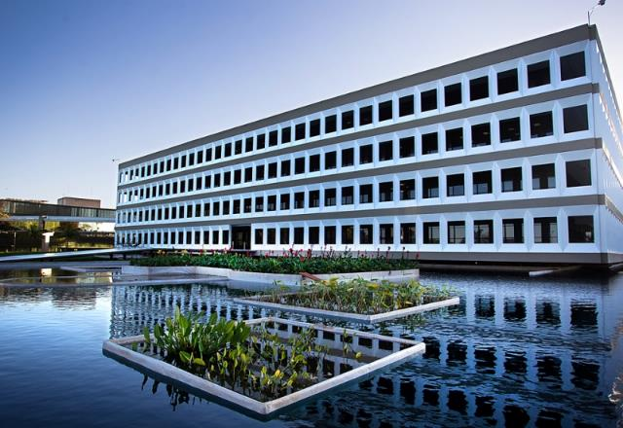
Thank you for your attention!
Tribunal de Contas da União – TCU
http://www.tcu.gov.br

